Slide 1
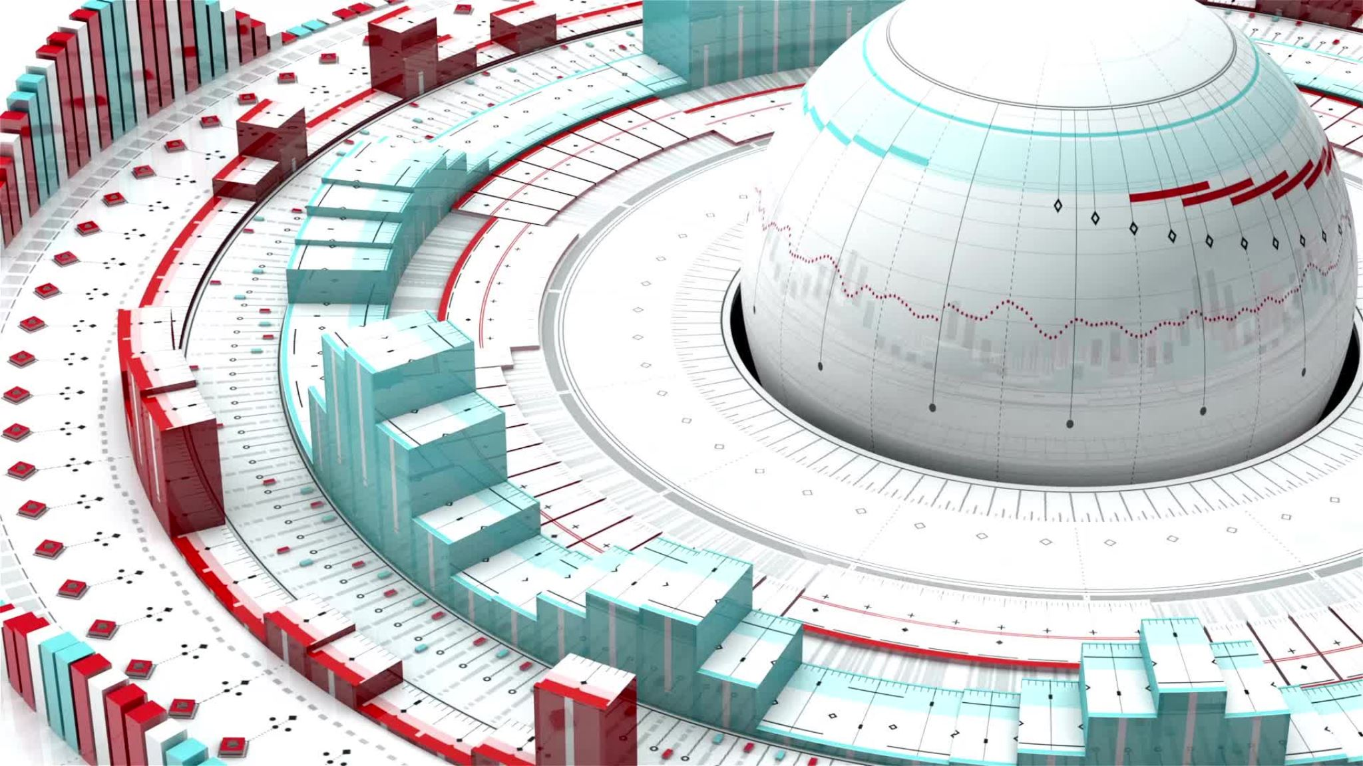
Campus network system design

Slide 2


Table of content
Table of content
INTRODUCTION
BACKGROUND OF THE PROJECT
OBJECTIVES AND AIMS
PROJECT SPECIFICATION
-CONTEXT OF THE PROJECT
-PROBLEM DOMAIN/STATEMENT
-THE REQUIREMENTS OF THE PROJECT
-NEEDS (TECHNICAL REQUIREMENTS)
-THE STAKEHOLDERS AND PARTICIPANTS AND THEIR ROLES
BODY
PROJECT PLAN DOCUMENTS
-SCOPE OF THE PROJECT
-PROJECT PHASES
-TASKS INVOLVED
-RISK MANAGEMENT CONCEPT
-HOW RISK WILL BE CALCULATED
-INVENTORY SHEET
DOCUMENTATION
-NETWORK DIAGRAMS
-WBS
-IP ADDRESS TABLE
-BUDGET
CONCLUTION

Slide 3
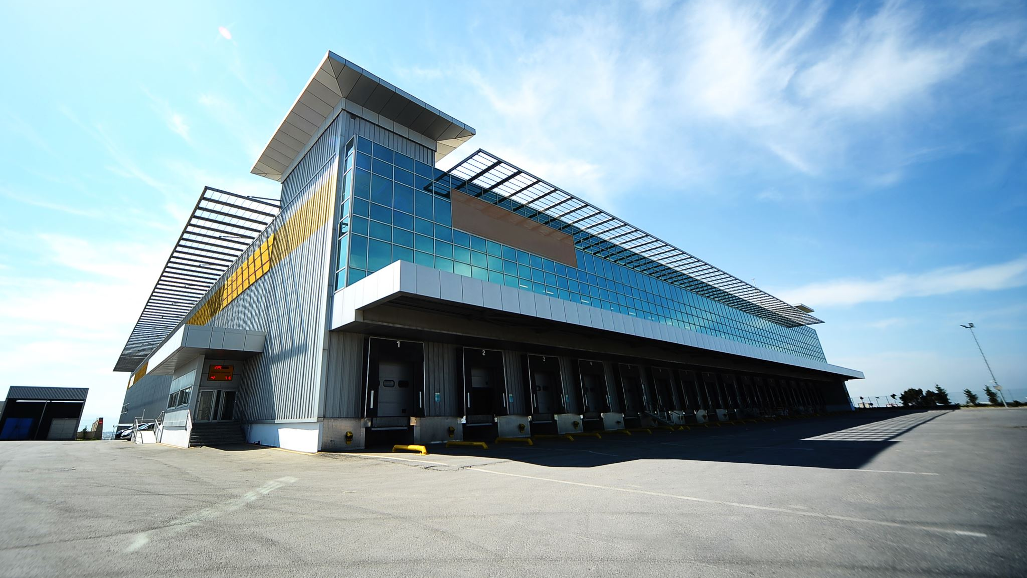
Introduction
This project is essential to ensure that all our 100 active users have
seamless and secure access to the network. Our college comprises
three main buildings, each with distinct requirements: the main
building, Building 1, and Building 2. To make it even more complex,
each building has a lobby area that requires wireless network access,
spanning a total of 200 square fit.
Our primary goals in this project include providing authorized
personnel with secure wireless access to the network, facilitating
internet sharing from a high-speed cable connection available in the
main building, and ensuring efficient connectivity for our 100 users,
each of whom possesses a computer device. Furthermore, we have
the added challenge of incorporating three large-speed printers in
each building into our network infrastructure.

Slide 4
Background of the project
*we are asked to design a network system for a college campus.
*which has three buildings.
*and it must be able to serve 100 active users.
*the network system must be improved and modified in order to meet to institution changing needs.

Slide 5
Objectives and aims
When designing a campus network system for three buildings with 100 active users, the goals and objectives must revolve around creating a secure, scalable, and robust network infrastructure that meets user needs
Here are some key goals and objectives:
Scalability:
Design the network to accommodate potential growth in the number of users and devices
Ensure the network can easily scale to meet future needs without significant disruption
Reliability
aims to create a highly reliable network that minimizes downtime

Slide 6

Use redundancy and failover mechanisms to ensure continuous connectivity
High Performance:
Ensures that the network provides high-speed, low-latency connections to support the various applications and services used by users
Security:
Implement strict security measures to protect network and user data

Slide 7

Project specification
What do we hope to achieve from this project
The aim is to change the entire system starting with new upgraded computers and computer software and make a connection between those computers add a Wi-Fi ,all of these devices and the printers and projector must be controlled in the main building by the IT (Information Technology) guru. elaboration within an organization or educational institution. The design aims to provide high-speed connectivity, centralized management, and scalability to accommodate present and future technological needs. .

Slide 8

Project specification List
What we will need to complete this project
1. Network Hardware
2. Cabling and Infrastructure
3. IP Addressing
4. Network Security
5. Network Monitoring and Management
6. Wireless Connectivity
7. Bandwidth Management
8. Redundancy

Slide 9
Context of the project
Network topology:
Select the appropriate network topology, such as star, bus, or ring topology, to connect the building
Hardware:
Choose network equipment such as switches, routers, access points, and cabling that can handle expected traffic and create opportunities for future growth
Subnet:
Divide the campus into subnets for efficient IP address management
Redundancy:
Implement redundancy to minimize downtime
Security:
Implement firewalls, intrusion detection systems, and access controls to protect against security threats
Implement strong encryption for data in transit
Bandwidth management:
Prioritizes network traffic to ensure that critical applications have enough bandwidth
Consider quality of service (QoS) mechanisms
of your campus with three buildings and 100 active users

Slide 10

Problem domain /statement
Wireless Connectivity: Install a reliable network of wireless access points with smooth roaming in every building. Network Monitoring: Use technologies for network monitoring to quickly detect and fix problems. Internet connectivity: Offer dependable, high-bandwidth internet access. Data Backup: To protect important data, put data backup and recovery procedures in place. overall campus Network Policy: Establish and implement rules and regulations for network usage. Cost-effectiveness: When designing the network, keep long-term sustainability and economical options in mind. Integration: Guarantee interoperability with both current and upcoming technological advancements.

Slide 11
Stakeholders and participants and their roles
Business Leaders/Executives: They set the network system's strategic goals and objectives, assign funds, and guarantee that it is in line with the organization's overarching plan. IT managers and administrators are in charge of the technical implementation, resource management on the network, and performance, security, and availability of the system. Network architects: They create the general architecture of the network, choose the technology stack, and make plans for redundancy and scalability. Experts in security: Charged with maintaining network safety, they spot weaknesses and put defenses in place to fend off attackers. End users are the people who will utilize the network to carry out their regular activities. For a design to be user-friendly, it is necessary to collect their requirements and input. Providers and Merchants: Vendors are important if you're buying hardware or software components. They supply the required tools.

Slide 12
Project scope
Plan
Plan scope management
Collect
Collect requirements
Define
Define scope
Create
Create WBS
Validate
Validate scope
Control
Control scope

Slide 13

Plan scope management
Define design goals: Clearly define the goals and objectives of the network system design. What are you trying to achieve with this system? Understanding the project and the goal is important. Identification of Stakeholders: Identify all stakeholders involved in the project, such as end users, IT teams, management and suppliers. Understand their needs and expectations. Create a scope statement: Create a detailed project scope statement that describes what is and is not in the scope of the project. This should include technical requirements, functionality and limitations. Work Breakdown Structure (WBS): Create a work breakdown structure to break the project into smaller, manageable tasks and parts. This helps to define the scope of work more precisely. Validation Validation: Create a process to validate the project and gain stakeholder acceptance. This ensures that everyone is on the same page with what is being delivered. Change Management Process: Define a change management process to handle potential scope changes. Determine who has the authority to approve or reject changes and how they will be documented and communicated.

Slide 14
Plan scope management
Scope Management Plan: Develop a scope management plan that describes how scope changes will be tracked, controlled and documented. This plan should include roles and responsibilities, communication methods and a schedule of comprehensive management activities. Risk assessment: Identify potential risks associated with extensive changes and how they may affect the project. Develop mitigation strategies to combat these risks. Communication Plan: Develop a clear communication plan to ensure that all stakeholders are notified of any changes or updates related to the project and its scope. Documentation: Maintain comprehensive documentation throughout the project, including meeting minutes, change requests and approvals. Training: Ensure team members and stakeholders understand the comprehensive management process and their roles within it. Regular reviews: Review and update the scope regularly as needed. This ensures that the project stays on track with its goals and that changes are well managed.

Slide 15
Project phases
Design: Foster an organization configuration plan that incorporates network geography, hardware choice, and IP address mapping. Characterize the solid remote access procedure, guaranteeing that main approved clients can associate with the organization. Make an organization graph to imagine the proposed framework.
Implementation: Secure the essential systems administration hardware, including switches, switches, passageways, and organized printers. Implement the design plan for network devices. Execute safety efforts, including access controls and encryption. Set up IP address the executives and distribution. 53
Testing and Quality Control: Direct extensive testing to guarantee network usefulness, security, and execution. Verify coverage and signal strength by testing wireless access points in lobby areas. Confirm that web sharing is functional.

Slide 16
Risk management concept
Risk identification
Risk analysis
Risk handling

Slide 17

Risk identification
The first element of a cybersecurity risk management framework is risk identification. 58 It is the process of identifying sources, events, and situations that could harm your network, such as hackers, malware, natural disasters, human error, or device failure. You should also identify assets at risk, such as data, devices, systems or services, and their value to your organization. Risk identification helps you establish scope and context for managing your cyber security risks.

Slide 18

Risk analysis
The second element of the cybersecurity risk management framework is risk analysis. This is the process of estimating the likelihood and impact of each risk identified on your network. You can use qualitative or quantitative methods or a combination of both to assess the likelihood and severity of risks. 59 You should also review existing controls and vulnerabilities that impact your cybersecurity. Risk analysis helps you prioritize risks and determine the level of risk you are willing to accept.

Slide 19
Risk handling
Risk reduction means implementing control or mitigation measures to reduce the likelihood or impact of a risk. Transferring risk means transferring responsibility or costs to another party, such as an insurance company or seller. Accepting risk means recognizing and accepting it, either because it is too low or because handling it is too costly. Addressing risk helps you balance the costs and benefits of cybersecurity

Slide 20
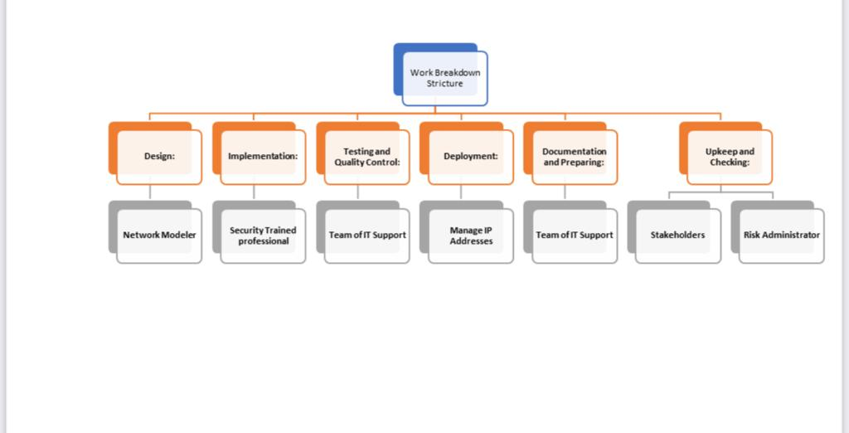
Work Breakdown Structure

Slide 21
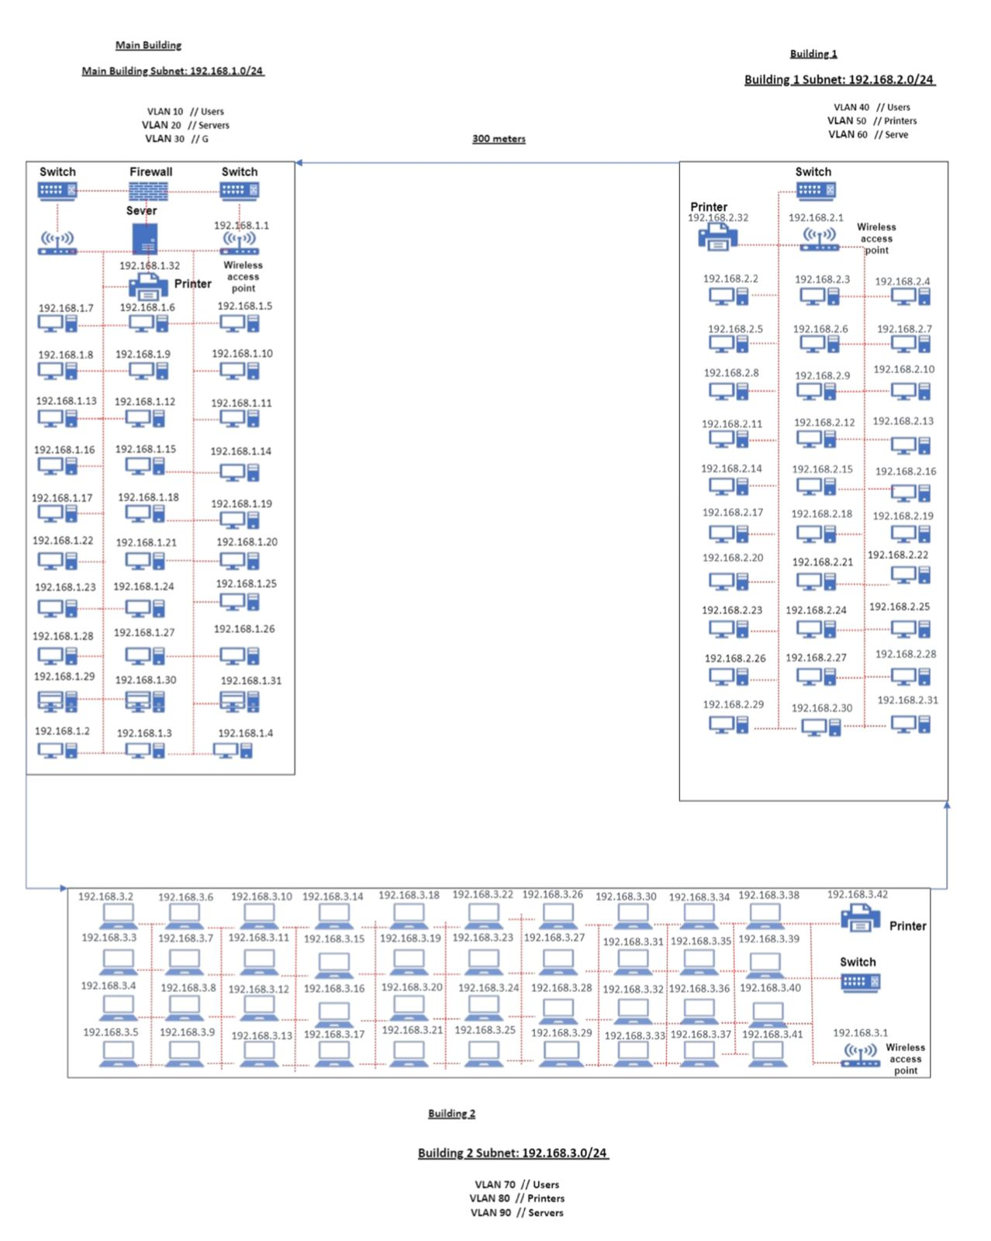
Network Design

Slide 22
Hardware Requirement
Server
Router
Switch
Printers
Computers/laptop

Slide 23

Budget
1. Hardware Costs:
Networking Equipment (Switches, Routers, Access Points): This will be a significant expense, and costs depend on the brand, capacity, and features of the equipment. Estimate R20,000 to R40,000.
Cabling and Infrastructure: Costs for structured cabling, fibber optics, and other network infrastructure components. Estimate R5,000 to R10,000.
Security Appliances (Firewalls, Intrusion Detection/Prevention): These are essential for network security. Estimate R5,000 to R10,000.
2. Software Costs:
Network Management and Monitoring Software: Estimate R2,000 to R5,000 for software licenses.
Security Software (Antivirus, Anti-Malware): Estimate R1,000 to R2,000 for licenses.
VLAN Configuration Software: Estimate R500 to R1,000.
Labor Costs:
Network Design and Implementation: Hiring network engineers or consultants for the initial setup. Labor costs can vary greatly, but estimate R20,000 to R40,000.
Ongoing Network Maintenance: Depending on your in-house IT team or external support, you may need to budget R10,000 to R20,000 annually for maintenance

Slide 24

Budget
4. Bandwidth Costs:
Internet Service Provider (ISP) Fees: Monthly or annual fees for the internet connection. Estimate R5,000 to R10,000 annually.
5. Miscellaneous Costs:
Training: Budget for training staff and administrators on network management and security. Estimate R2,000 to R4,000.
Warranty and Support Contracts: Costs for ongoing support and equipment warranties. Estimate R5,000 to R10,000 annually.
6. Contingency:
It's a good practice to include a contingency fund of 10-15% of your total budget to account for unexpected expenses.
7. Total Budget Estimate:
Based on the above estimates, a rough budget for the initial setup could range from R50,000 to R100,000, with an additional R15,000 to R30,000 in annual recurring expenses for maintenance and internet connectivity.

Slide 25

Conclusion
Scalability, redundancy, security, VLANs, and bandwidth allocation have been carefully considered and integrated into the network's design. These elements ensure that Campus College's network remains flexible, highly available, and capable of supporting diverse academic and administrative operations.
As we navigate the ever-changing technological landscape, the pursuit of dependable and fast connectivity remains at the forefront of our mission. It is our pledge to uphold the trust, confidentiality, and integrity of our academic and administrative operations while providing a platform that fosters excellence.
In summary, the network we envision is not merely a system but a strategic asset, an enabler of growth, and a safeguard for the future of Campus College.

